Slide 1
Each image contains six missing words hidden within the picture. Can you find them?

Slide 2
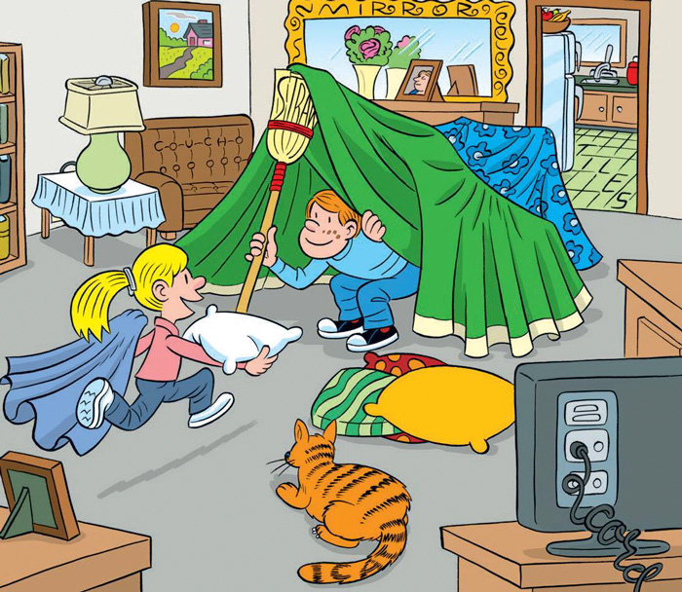
Notes:
Couch
Mirror
Cord
Tiles
Cat
Straw

Slide 3
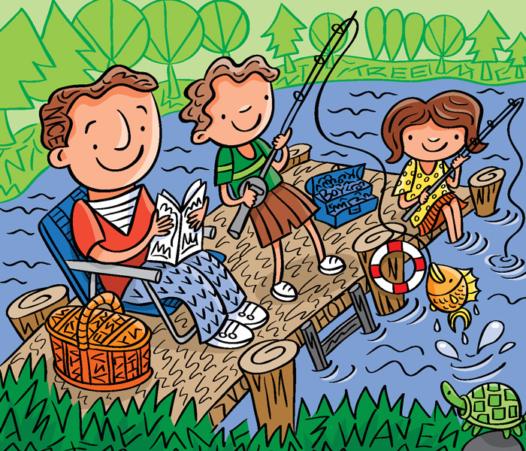
Notes:
Tree
Fish
Boy
Wave
Nice
Hot

Slide 4
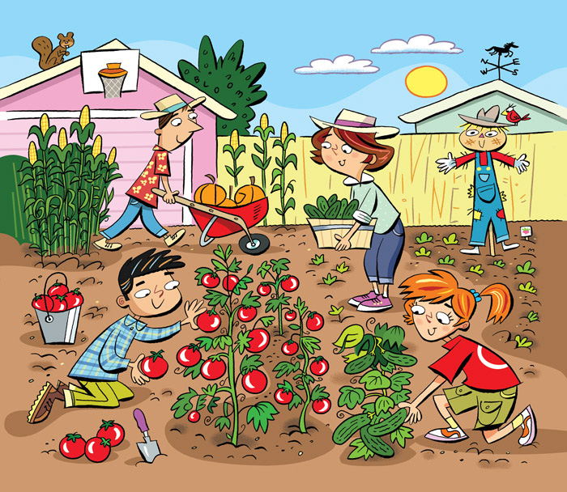
Notes:
Garden
Seed
Vine
Farm
Dig
Bloom

Slide 5
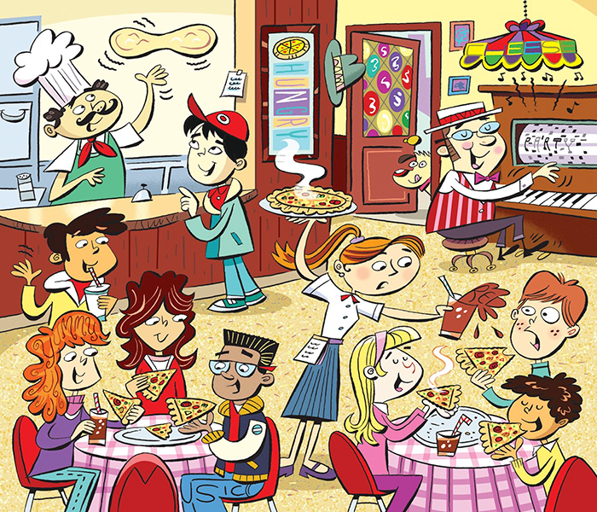
Notes:
Party
Music
Red
Cheese
Hungry
Yummy

Slide 6
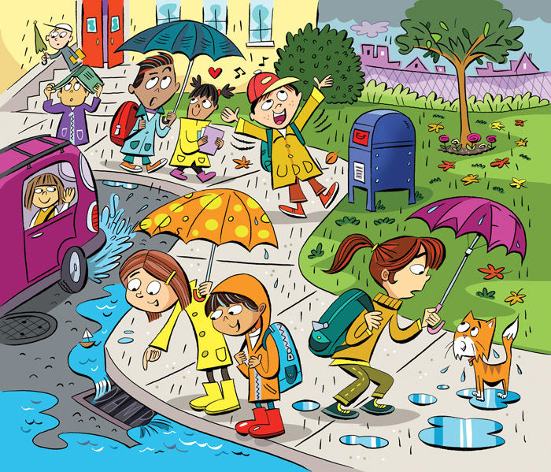
Notes:
Puddle
Wet
Stormy
Showers
Damp
Clouds

Slide 7
Notes:
Story
Novel
Page
Book
Words
Read

Slide 8
Notes:
Cow
Guitar
Wow
Iowa
Laugh
Orange

Slide 9
Notes:
Cut
Man
See
Snow
Tell
Cool

Slide 10
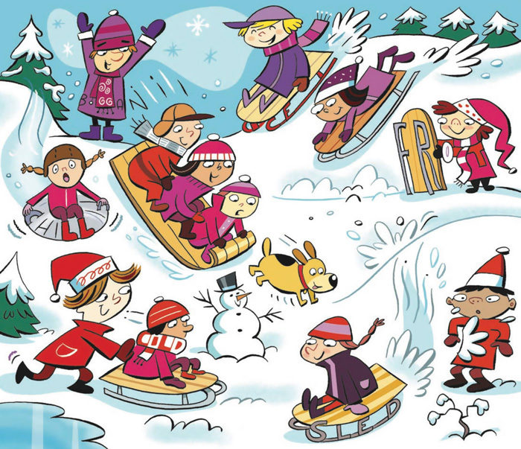
Notes:
Frost
Cold
Chill
Toboggan
Sled
Ice

Slide 11
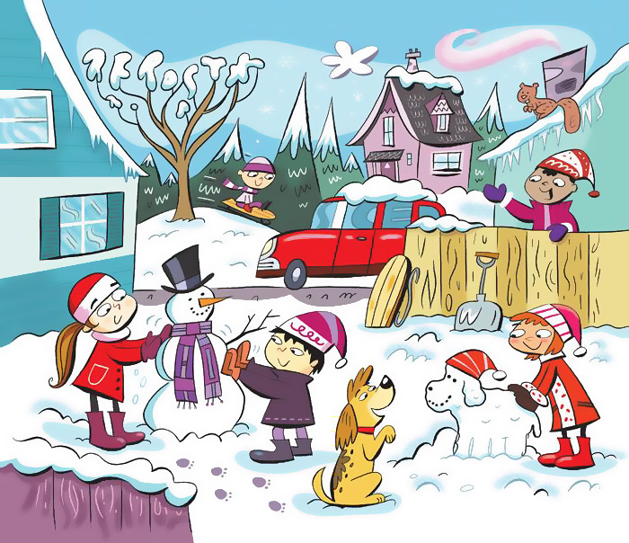
Notes:
Frost
Snow
Boots
Chill
Ice
Mittens

