Slide 1
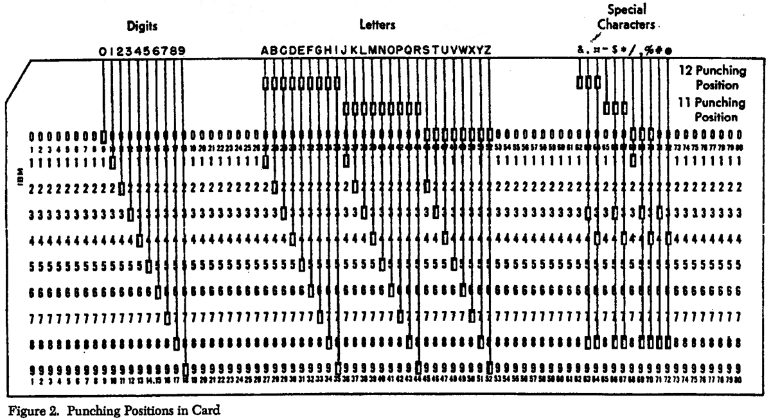
For each example of memory, how much data can be stored?

Slide 2
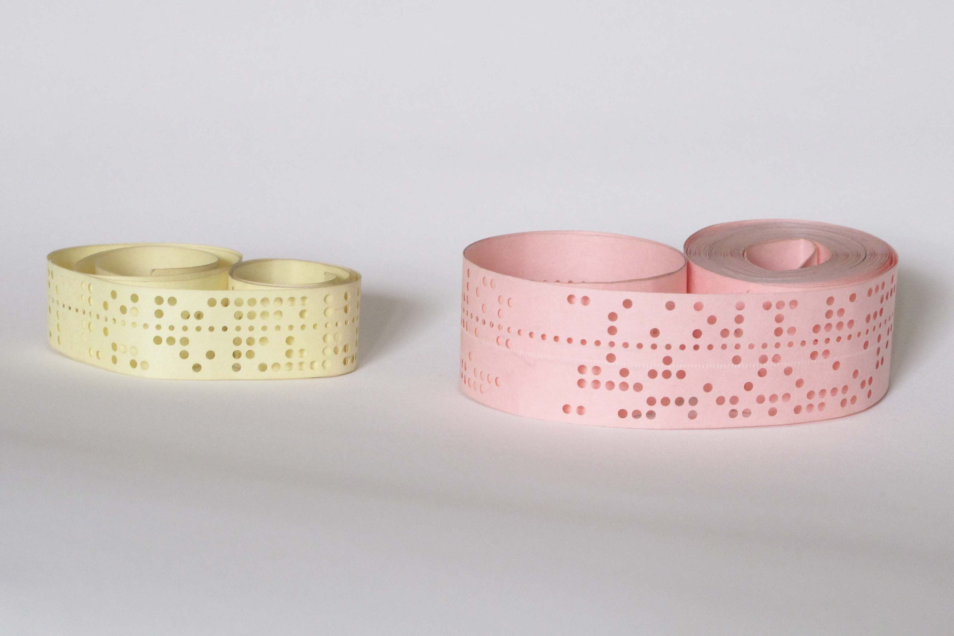
Punched tape

Slide 3
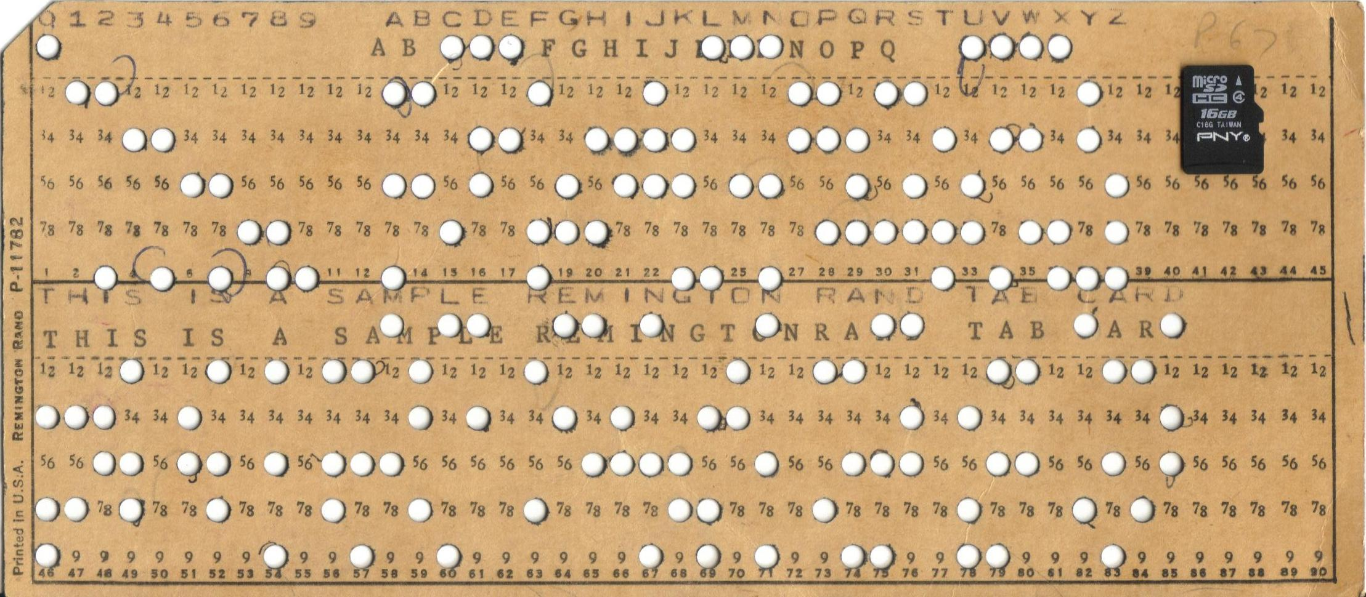
Punched card

Slide 4
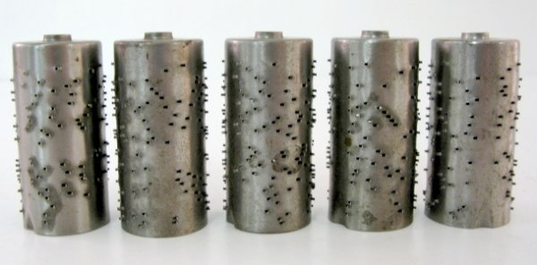
Music cylinder

Slide 5
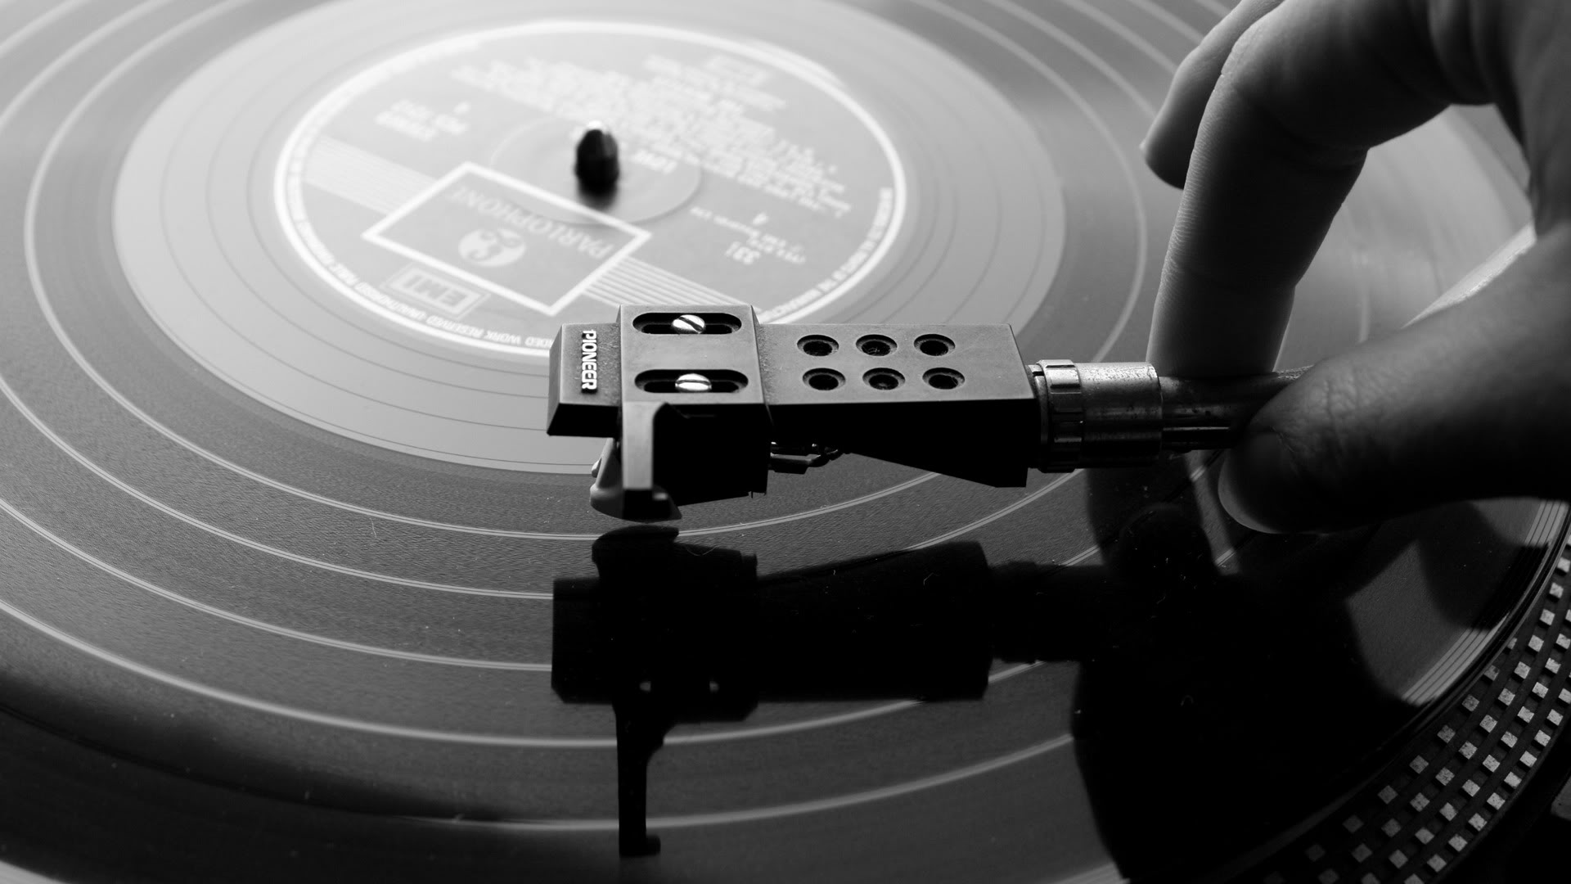
LP

Slide 6
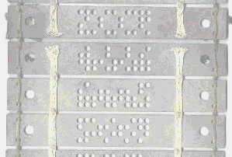
Jacquard punched card...

Slide 7
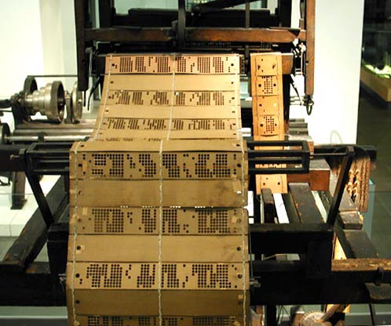
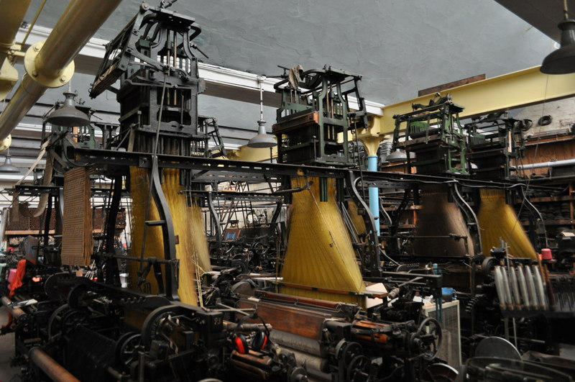
...used in the Jacquard loom

Slide 8
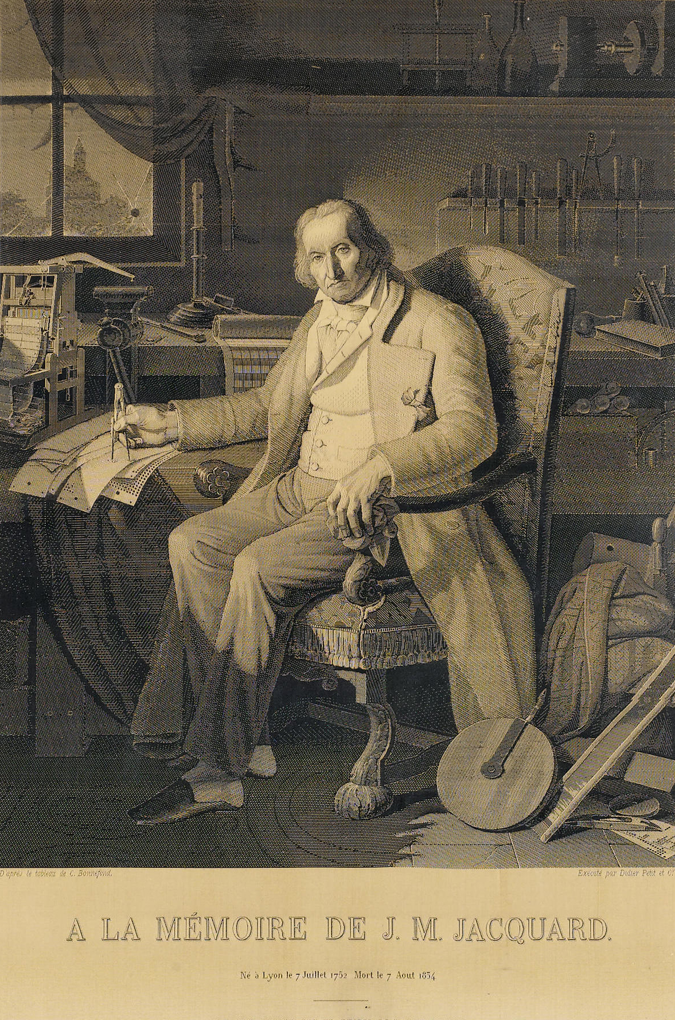
Jacquard portrait
x 20000 made ->
out of silk
(about 860 bytes)

Slide 9
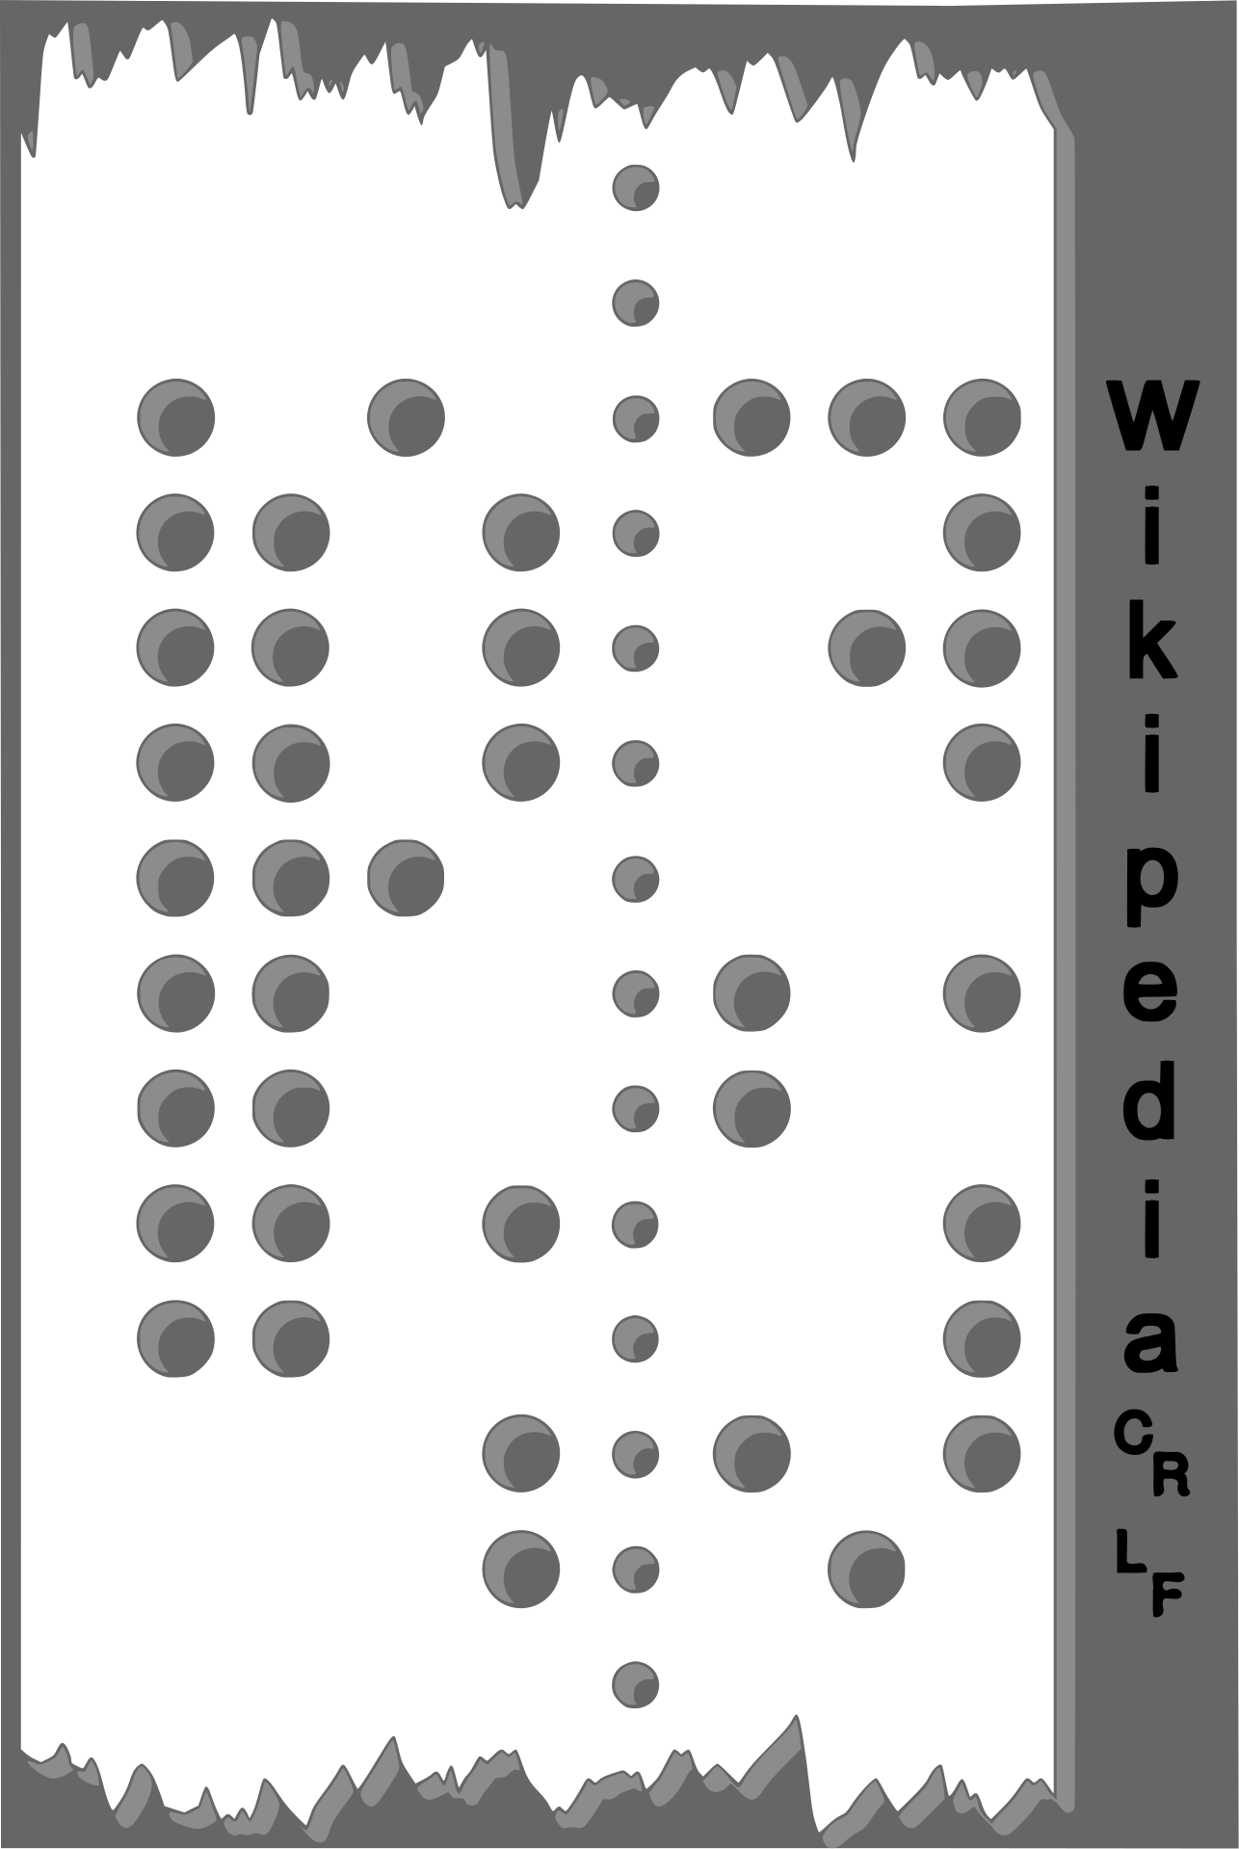
Data stored on punched tape example
This piece of tape stores some 7-bit ASCII characters from top to bottom.
Can you decode it?

Slide 10
Clue
The 1st character is:
1 0 1 | 0 1 1 1

Slide 11
Clue 2
Hex
0x 5 | 7
Binary
1 0 1 | 0 1 1 1

Slide 12
Answer

