Slide 1
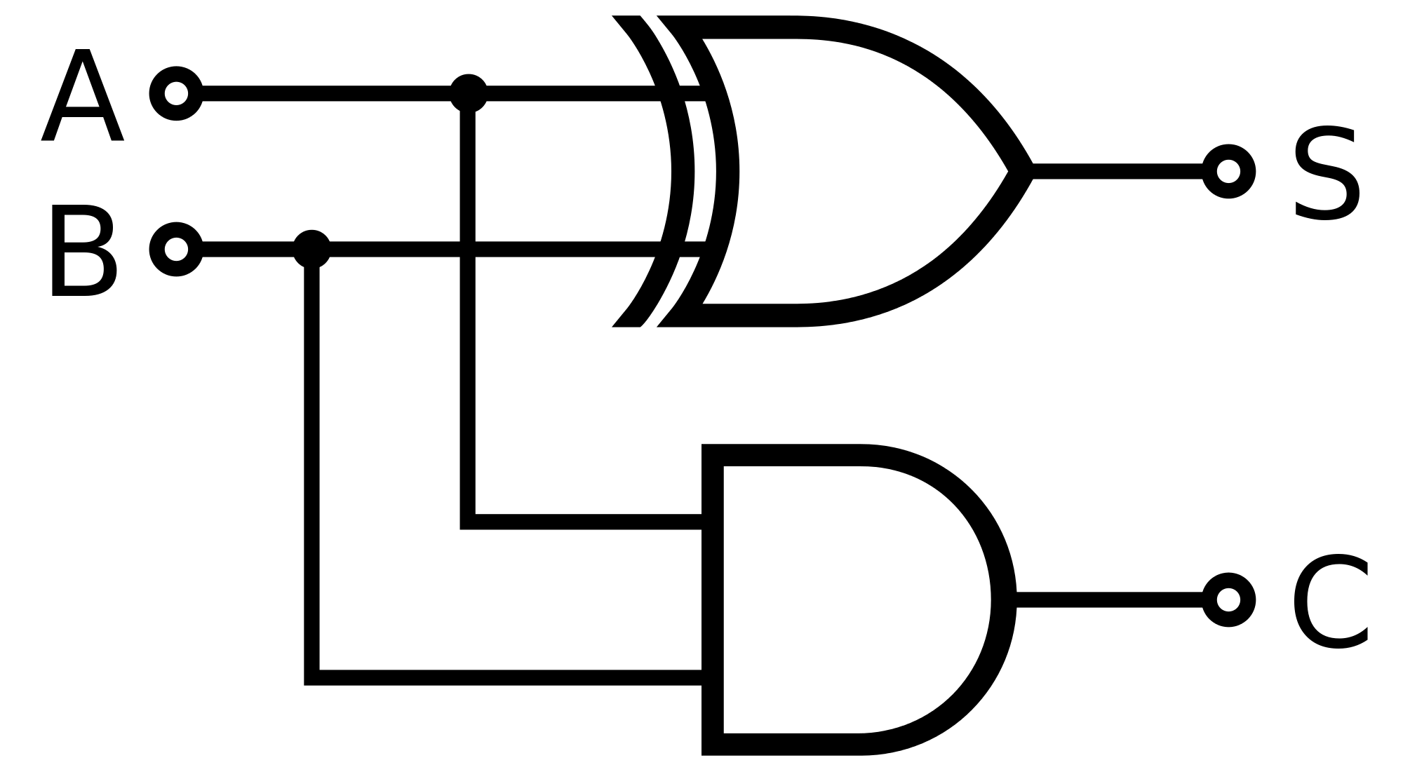
Logic Gates
LO:
To understand what a logic gate is.
To understand how they function.

Slide 2
Why???

Slide 3
Why?
Logic gates are the fundamental bedrock of computing.
A large part of a CPU is made from millions of logic gates.
All binary calculations can be performed using logic gates.
It's in the syllabus and it will appear in the exam!

Slide 4
What are they?

Slide 5
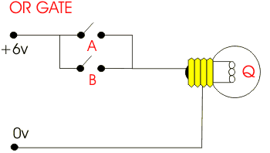
What are they?
Logic gates are created from simple electronic components.

Slide 6
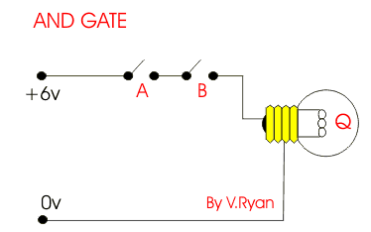
What are they?
They take binary input and produce a binary output.

Slide 7
What are they?
By "binary" we mean high voltage and low voltage.
But it is more convenient for humans to represent these voltages as binary 1 and 0.

Slide 8
What are they?
Logic gates can be arranged in specific ways to perform certain calculations.
For example, this arrangement of two logic gates adds two binary bits together:

Slide 9
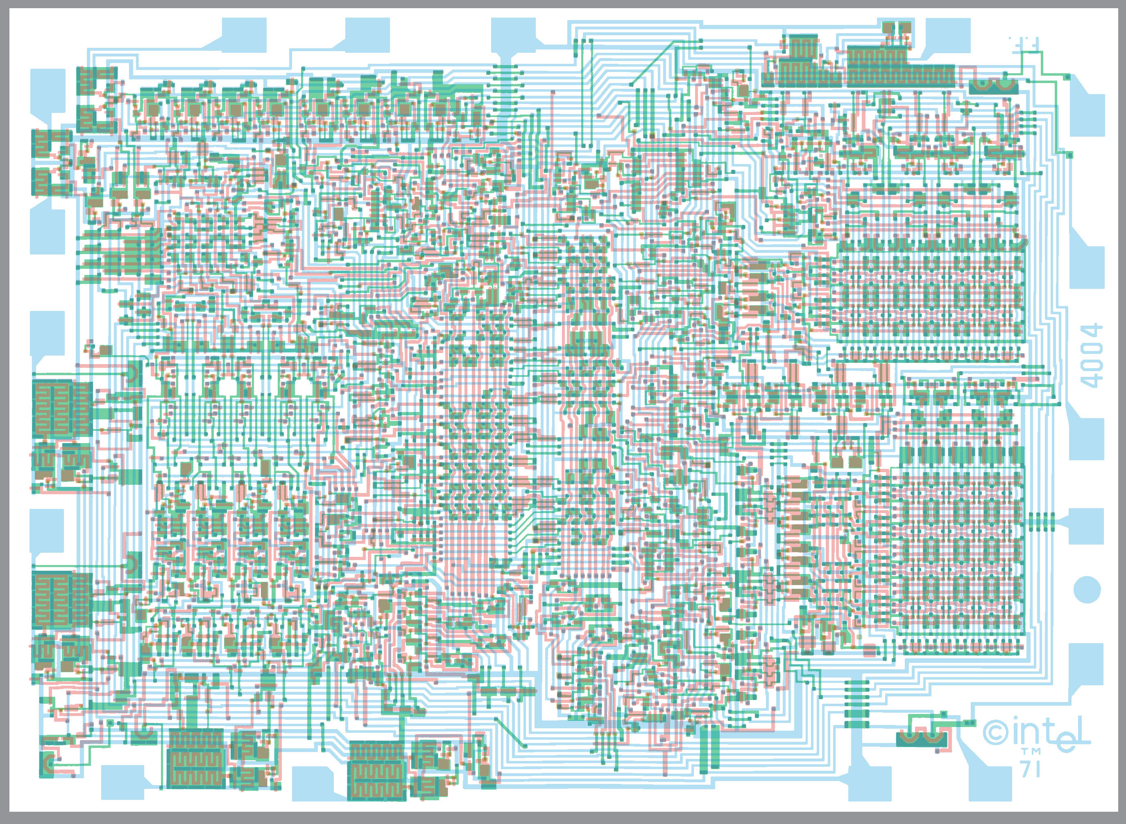
What are they?
On modern CPUs, logic gates are created using transistors.
By combining lots (millions) of logic gates all of the low level instructions a CPU needs can be catered for.

Slide 10
How are they represented?

Slide 11
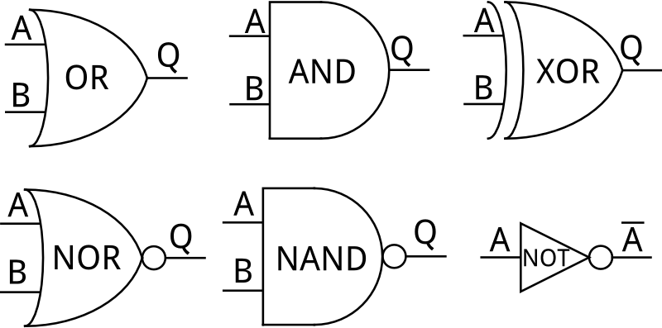
How are they represented?
Rather than drawing complicated electronic diagrams for each logic gate, special symbols are used for each.
Note that the gate names are in CAPITALS!
Output:
Any other letter including the inverse of one or more inputs.
Input:
A, B, C, etc.
IMPORTANT: Make a notes of these!

Slide 12
How are they represented?
IMPORTANT:
Notice that a small circle is used to invert a result or an input.
Inverting is called NOT.
This can be represented with a bar over the top of a letter.

Slide 13
Logic gates in action

Slide 14
Logic gates in action
Create some tables like this:
The X column is the output from the gate.
Leave room for a diagram next to each.

Slide 15
Logic gates in action
Go to this website:
http://www.neuroproductions.be/logic-lab/
For each table, use a logic gate, two inputs (simple switches will do) and an output (like a light) to find the output (X column) values in each table.
Draw each working logic diagram next to each table. Use the standard logic gate symbols you drew earlier.

Slide 16
Answers

Slide 17
Logic gates in action
You should end up with these results:

Slide 18
Logic gates in action
Tables such as these are called TRUTH TABLES.
Truth tables quickly and clearly show the outputs for given inputs for logic gates.

Slide 19
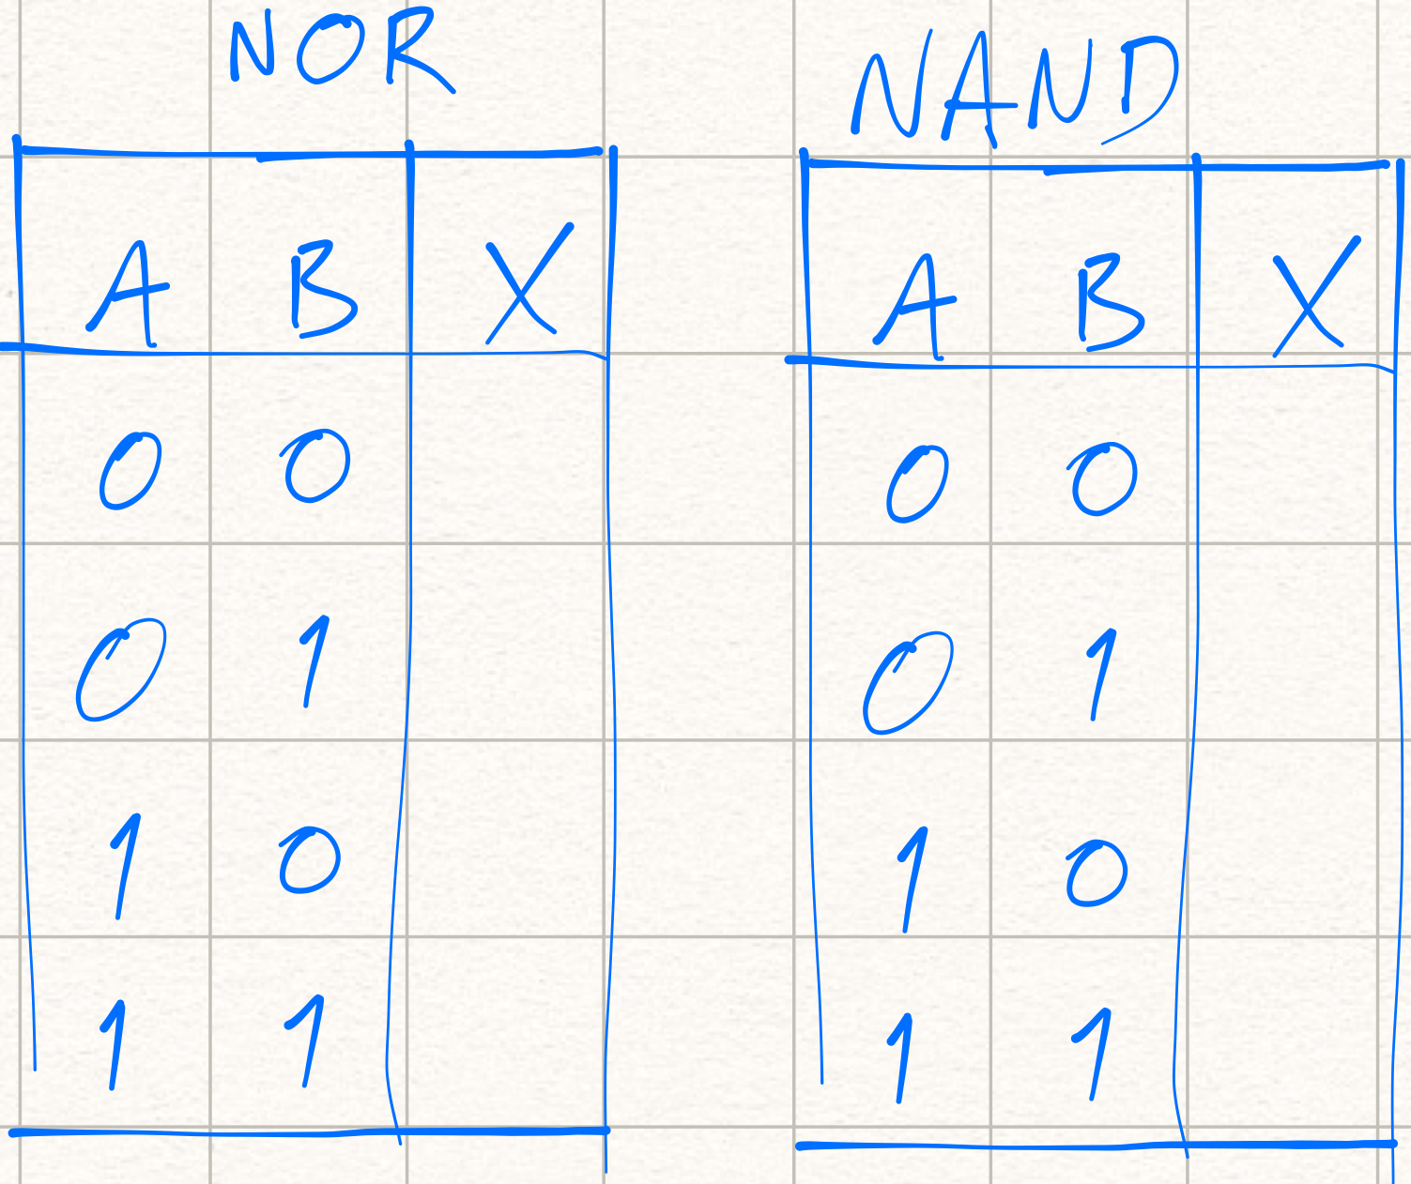
Logic gates in action
Now, create completed truth tables for NOR and NAND gates.
Use the same website if you wish.

Slide 20
Answers

Slide 21
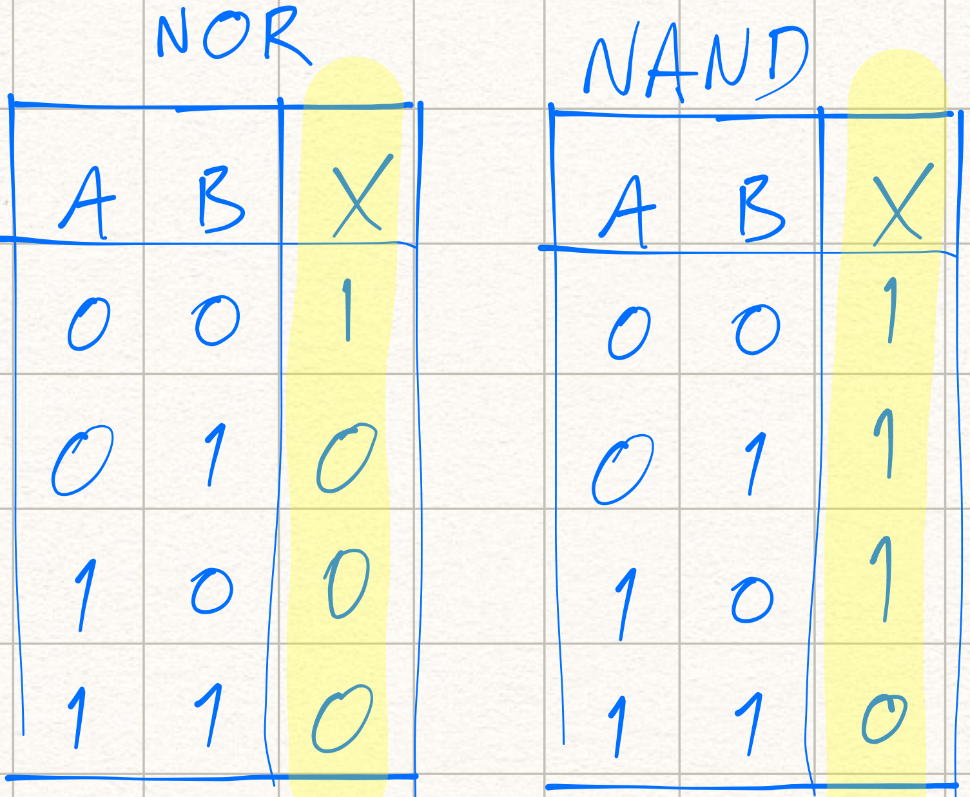
Logic gates in action
Did you get these results?

Slide 22
Logic gates in action
This arrangement of gates is called a half adder. It is used to add up two binary bits.
A & B are inputs
S is the Sum output
C is the Carry output

Slide 23
Logic gates in action
Create a truth table for the half adder.
Construct the half adder on the website.
Complete the truth table output columns S & C

Slide 24
Answers

Slide 25
Logic gates in action
Logic diagram using the neuroproductions.be website:

Slide 26
Logic gates in action
Half adder truth table completed:
Notice that the S output is standard XOR output but we also have an AND gate taking care of the carry when the result of A + B is too large for one bit to hold.

Slide 27
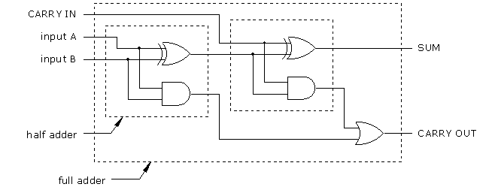
Logic gates in action
Two half adders together make a full adder.
Put a few full adders together and you have a complete binary adding system.

Slide 28
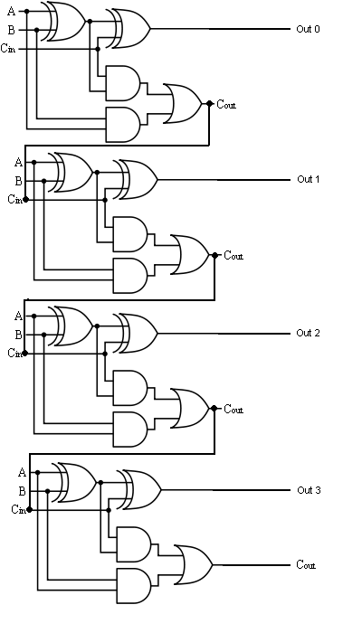
Logic gates in action
4 bit system using four full adders.
Notice that the carry bit (Cout) cascades to the next full adder.

Slide 29
Logic gates summary

Slide 30
Logic gates summary
Logic gates are used by CPUs for performing calculations and logical operations
They accept binary inputs and produce binary outputs
They can be represented using symbols rather than complicated electronic diagrams
They produce truth tables that are a clear representation of the function of the logic gate
They can be arranged to create complex but logical processing

